Slide 1
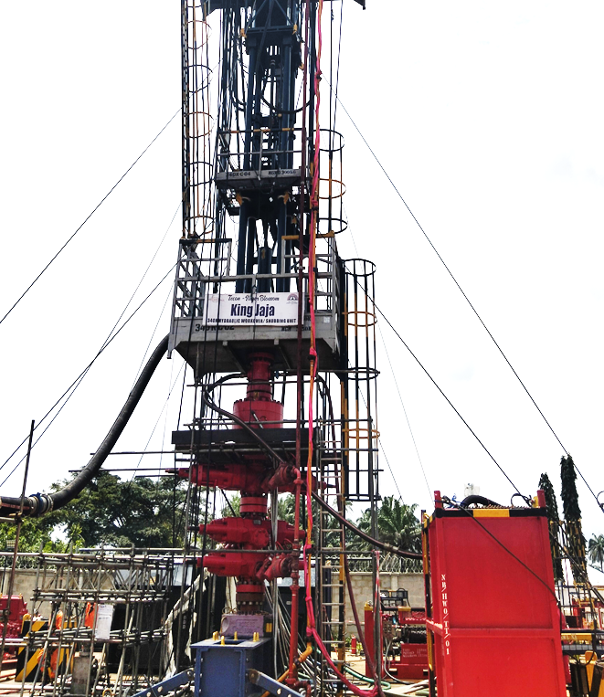

AAR FOR TOTAL OBAGI 80 WORKOVER OPERATION
24th February 2026

Slide 2







AGENDA
SECTION 1 : QHSE Performance Review
SECTION 2: OPERATIONS PERFORMANCE REVIEW
Introductions
Operations Summary
Safety Moment :
NPT Analysis
QHSE Analysis
Equipment performance
STOP card review
Highlights, lowlights and Recommendations

Slide 3
AIM OF AAR
The essence of this AAR is to enable us analyze our performance in the operation and to establish improvement options and adopt key learnings for future operations.

Slide 4
COMPANIES AND SERVICES RENDERED
S/N | SERVICE RENDERED | COMPANY
1 | LEASE OWNERS | TOTALENERGIES E&P NIGERIA
2 | RIG OWNERS | TECON OIL SERVICES
3 | FISHING | TECON OIL SERVICES
4 | CEMENTING | WEAFRI
5 | WIRELINE | GEOPLEX DRILLTEQ
6 | FLUIDS AND CHEMICALS | HAMILTON
7 | WELLHEAD | CAMERON-SLB
8 | SLICKLINE | OILQUEST
9 | MUDLOGGING | JIMCOL
10 | GRAVEL PACKING | HALLIBURTON
11 | FILTRATION | FILCO
12 | SOLID CONTROL | ALLMAN
13 | SCAFFOLDING | CE-STALONG
14 | CATERING SERVICES | CORDEAU CATERING

Slide 5
WELL OBJECTIVE
Recomplete OBAGI 80 well to be a Gas producer targeting the Level VII and Level VIII reservoirs.
OB-80 is planned to be completed as single-string selective dual zone gravel pack with 5 ½” 13Cr slot 8 screens in the lower completion.
Upper completion shall be completed with 3 ½” 13 Cr tubing equipped with HHC production packer, Permanent downhole gauges, TRSCSSV and Gas-lift valves.
Incident and injury free operation.

Slide 6
QHSE STATISTICS FOR OBAGI 80: FROM 22ND JULY -29TH DEC, 2025
Unsafe Act/unsafe cndition | 3060
Safe Practices | 4438
Total stop cards reported | 7498
Near Miss | 3
First Aid Case | 0
CUM. MAN HOUR | 151,980
MTC | 0
Drills | 20
HSE Meetings | 25
Community invasion | 0
Theft incidents | 0
Env. Spill/Pollution | 1
Manager’s Visit | 12
Audit/Inspection | 16
Restricted Medical Lost Time work case (RMTC) | 0
LTI | 0
RTA / WTA | 0
Days without LTI first day to site (01-07-24 to 29-12-25) | 164 DAYS

Slide 7
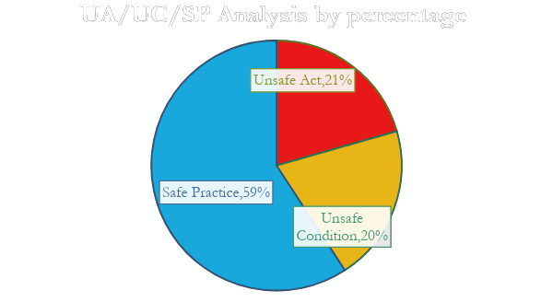
QHSE STATISTICS CONT’D
Unsafe Act | Unsafe Condition | Safe Practice
1,543 | 1,517 | 4,438

Slide 8
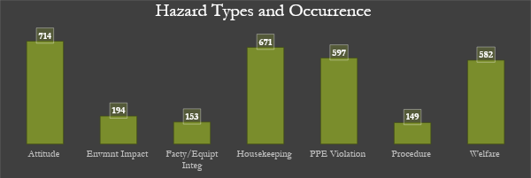
HAZARD TYPES AND OCCURRENCE
Hazard Types | Occurrence
Attitude | 714
Envmnt Impact | 194
Facty/Equipt Integ | 153
Housekeeping | 671
PPE Violation | 597
Procedure | 149
Welfare | 582

Slide 9
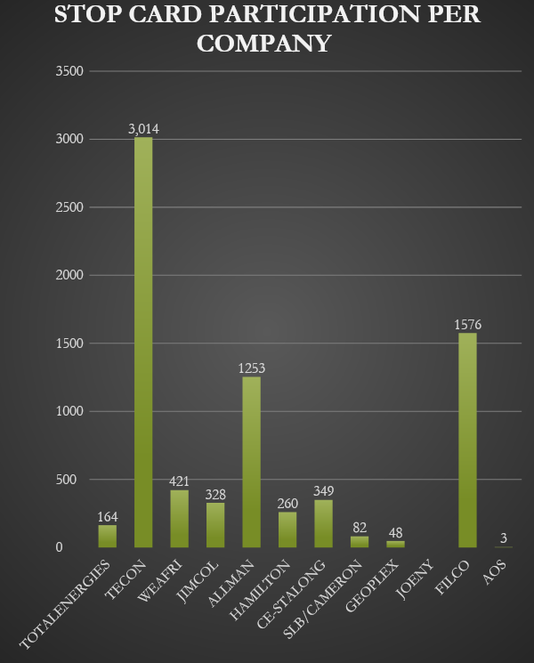
STOP CARD PARTICIPATION PER COMPANY
COMPANY | STOP CARD PARTICIPATION
TOTALENERGIES | 164
TECON | 3,014
WEAFRI | 421
JIMCOL | 328
ALLMAN | 1253
HAMILTON | 260
CE-STALONG | 349
SLB/CAMERON | 82
GEOPLEX | 48
JOENY | 0
FILCO | 1576
AOS | 3

Slide 10
HIGHLIGHT OF QHSE REVIEW
Achieved Zero LTI.
100% HSE meeting compliance.
Achieved up to 90% drill Compliance
Management field engagement far above target.

Slide 11
LOWLIGHT OF QHSE REVIEW
CRANE NOT CERTIFIED FOR MAN-RIDING FOR RESCUE AT HEIGHT

Slide 12
OPERATION SUMMARY
RIG MOVE FROM TECON ENERGY PARK P/H TO OBAGI WELL 80 SITE AND SPOTTING OF EQUIPMENT.
BOP TESTS, R/U HWU, FUNCTION TEST HWU & RIG ACCEPTANCE
RETRIEVE OLD COMPLETION TBG (LS & SS) ABOVE A5 PACKER
WIRELINE OPERATION - TO CUT ABOVE & BELOW A5 PACKER
A5 PACKER RETRIEVAL
L/S RETRIEVAL (BELOW A5 PACKER) + WIRELINE OPS (RCT)
SC 1 PACKER RETRIEVAL
BLAST JOINT RECOVERY
SAND SCREEN RECOVERY
MILLING & RETRIEVAL OF UPPER MODEL D PACKER
L/S & BLAST JOINT ABOVE LOWER MODEL D PACKER
LIH OLD L/S ABOVE LOWER MODEL D PACKER
S/LINE GUAGE CUTTER & CAMERA OPS
E-LINE GUAGE RING DRIFT, MULTI FINGER CALIPER, RADIAL BOND TOOLS OPS
CEMENT PLUGS OPS
R/D HWU

Slide 13
OBAGI 80 ACTIVITIES TIME ANALYSIS
S/N | ACTIVITY | TIME FRAME
1 | RIG MOVE FROM TECON ENERGY PARK P/H TO OBAGI WELL 80 SITE AND SPOTTING OF EQUIPMENT. (12HR OPERATION) | 12 DAYS
2 | BOP TESTS, R/U HWU, FUNCTION TEST HWU & RIG ACCEPTANCE (24HRS OPERATION) | 3 DAYS
3 | RETRIEVE OLD COMPLETION TBG (LS & SS) ABOVE A5 PACKER | 3 DAYS
4 | WIRELINE OPERATION - TO CUT ABOVE & BELOW A5 PACKER | 1 DAYS
5 | A5 PACKER RETRIEVAL | 4 DAYS
6 | L/S RETRIEVAL (BELOW A5 PACKER) + WIRELINE OPS (RCT) | 9 DAYS
7 | SC 1 PACKER RETRIEVAL | 3.5 DAYS
8 | BLAST JOINT RECOVERY | 4 DAYS
9 | SAND SCREEN RECOVERY | 5.3 DAYS
10 | MILLING & RETRIEVAL OF UPPER MODEL D PACKER | 10 DAYS
11 | L/S & BLAST JOINT ABOVE LOWER MODEL D PACKER | 2.75 DAYS
12 | LIH OLD L/S ABOVE LOWER MODEL D PACKER | 5 DAYS
13 | S/LINE GUAGE CUTTER & CAMERA OPS | 7 DAYS
14 | E-LINE GUAGE RING DRIFT, MULTI FINGER CALIPER, RADIAL BOND TOOLS OPS | 1.5 DAYS
15 | CEMENT PLUGS OPS | 6.25 DAY
16 | R/D HWU | 2 DAYS
 | TOTAL NUMBER OF DAYS SPENT ON OB 80 | 154 DAYS

Slide 14
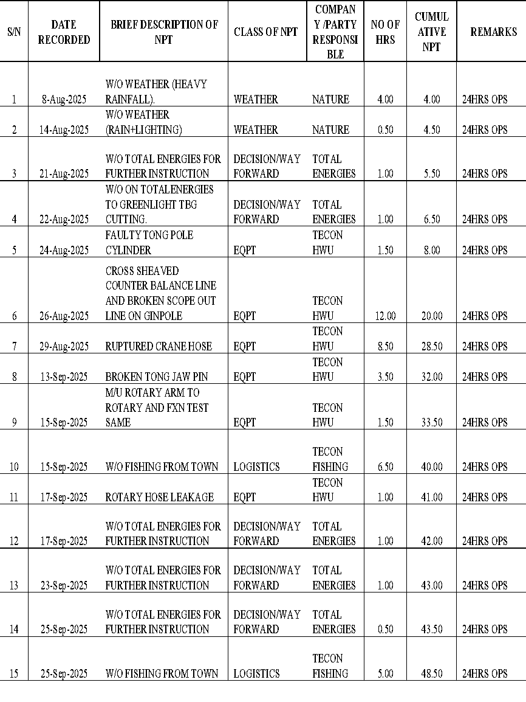
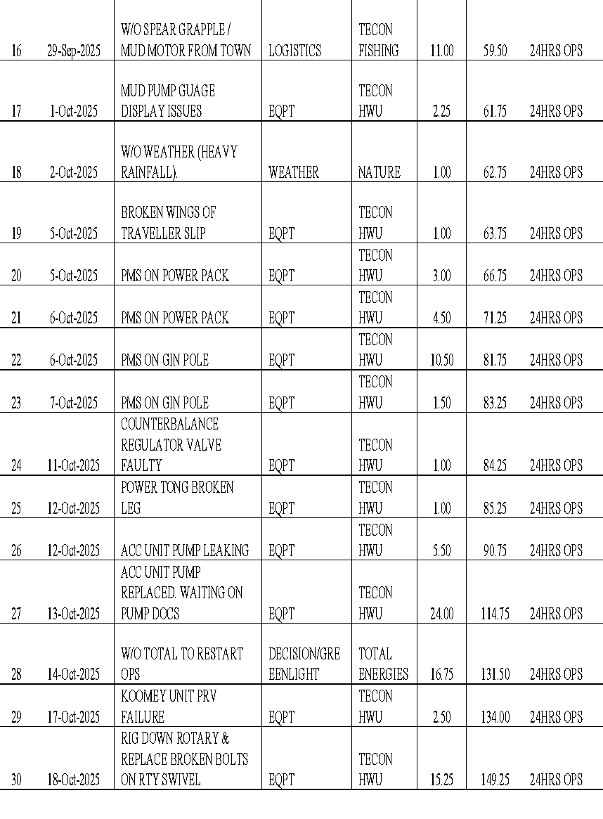
NPT SUMMARY

Slide 15
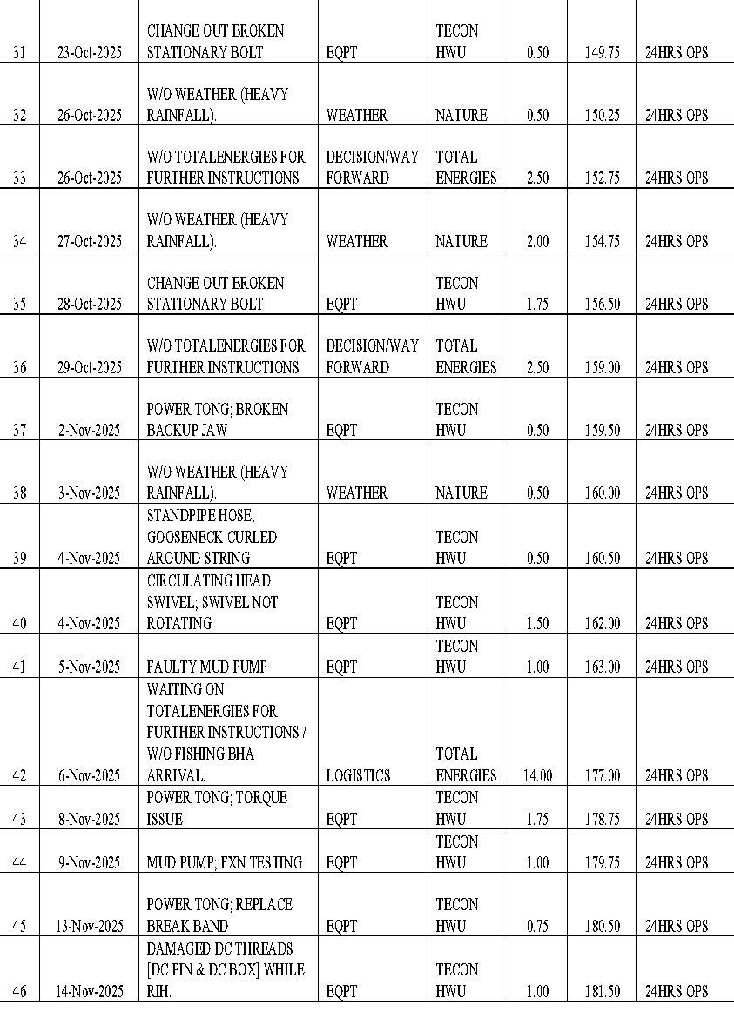
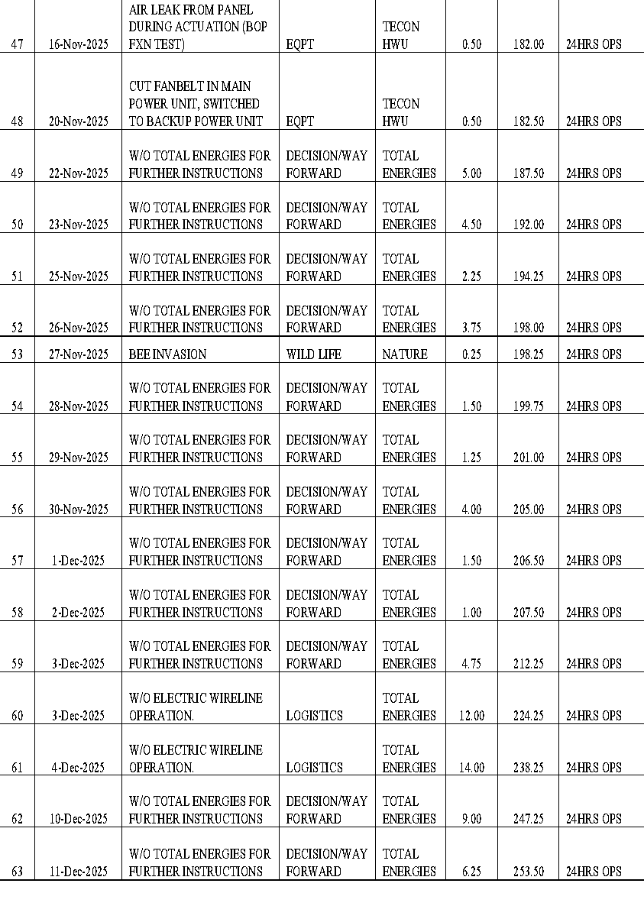
NPT SUMMARY CONT’D

Slide 16
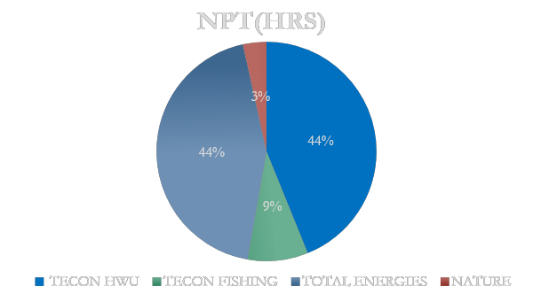
NPT ANALYSIS BY PARTY
S/N | COMPANY/PARTY | NPT(HRS)
1 | TECON HWU | 111.25
2 | TECON FISHING | 22.50
3 | TOTAL ENERGIES/SERVICE COY | 111.00
4 | NATURE | 8.75

Slide 17
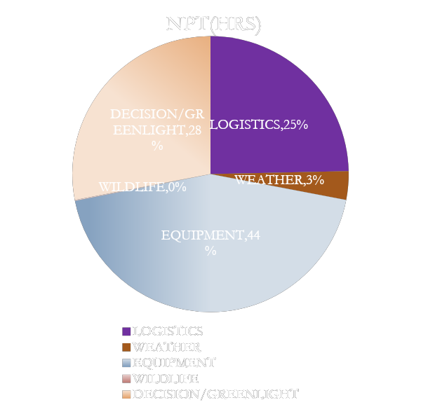
NPT ANALYSIS BY CLASS
S/N | CLASS | NPT(HRS)
1 | LOGISTICS | 62.50
2 | WEATHER | 8.50
3 | EQUIPMENT | 111.25
4 | WILDLIFE | 0.25
5 | DECISION/GREENLIGHT | 71.00

Slide 18
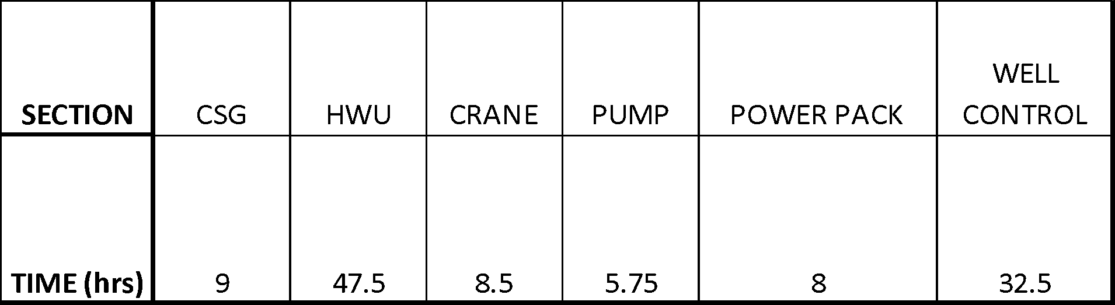
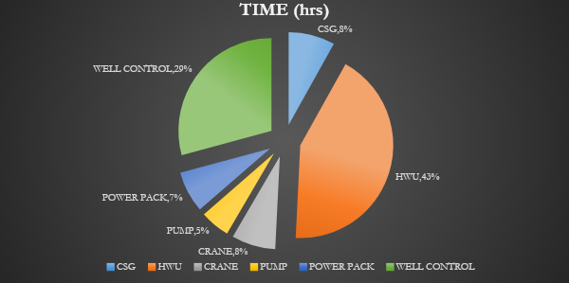
TECON-HWO (EQUIPMENT) NPT BREAKDOWN

Slide 19
OPERATIONAL EFFICIENCY SUMMARY
WELL | WORK SCOPE | TOTAL DURATION (HRS) | TOTAL NPT (HRS) | EFFICIENCY (%)
OBAGI 80 | WORKOVER OPERATION | 2904 | 253.5 | 91.27%
EFFICIENCY = 1- (NPT/DURATION)*100%

Slide 20
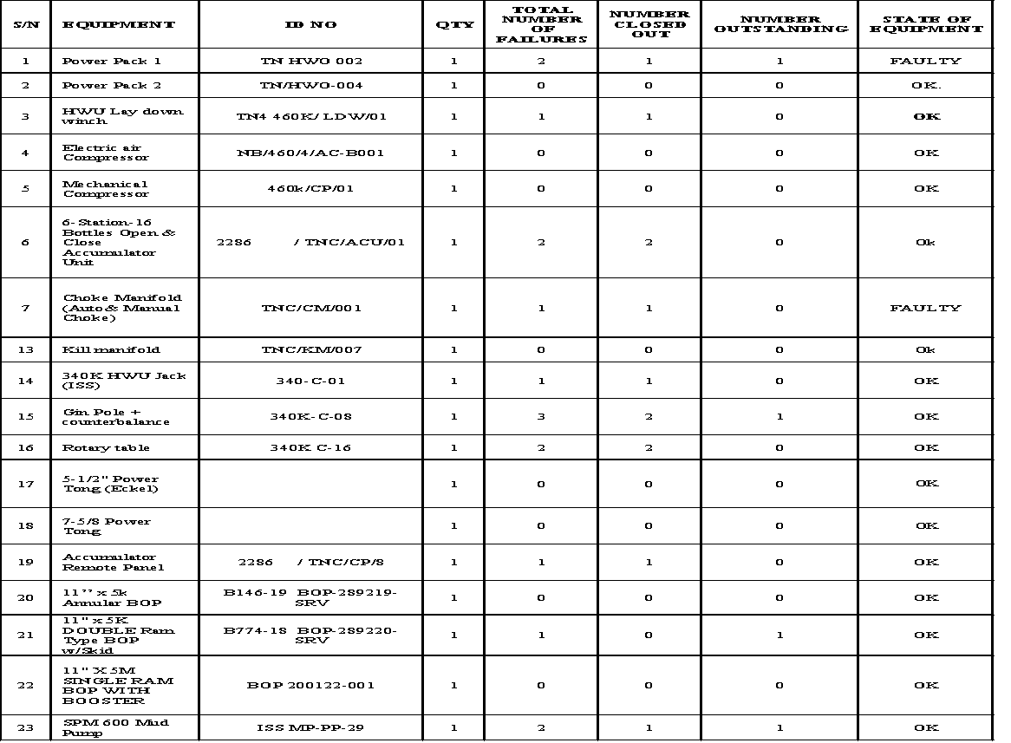
EQUIPMENT PERFORMANCE INDEX FOR OB 80

Slide 21
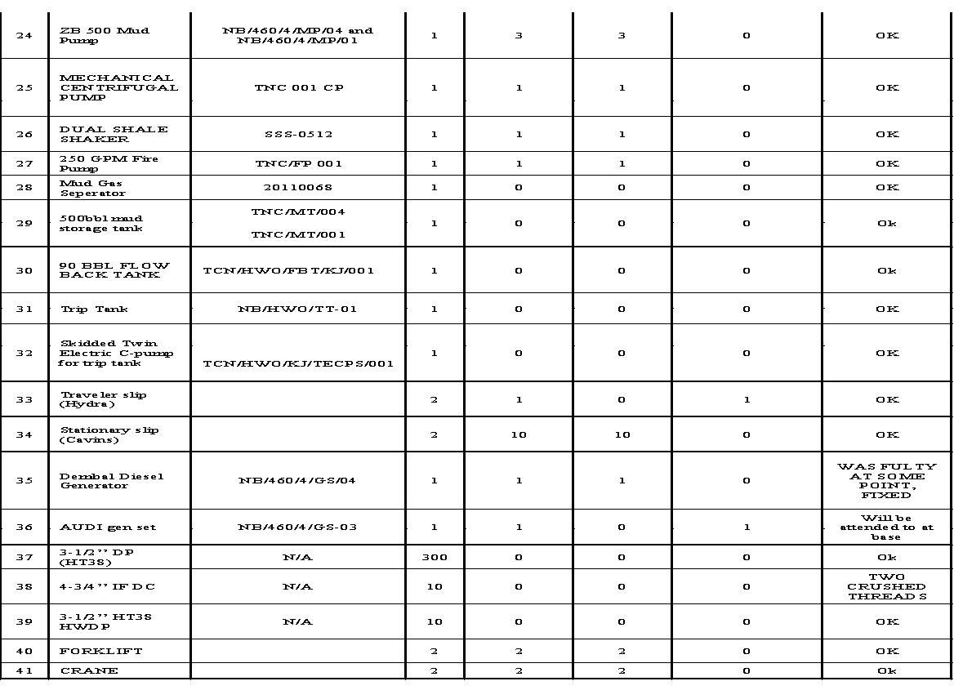
EQUIPMENT PERFORMANCE INDEX FOR OB 80 CONT’D

Slide 22
EQUIPMENT PERFORMANCE INDEX FOR OB 80 CONT’D
EQPT FAILURES | CLOSED OUT | OPEN ITEMS
39 | 33 | 6

Slide 23
EQUIPMENT ISSUES AT OBAGI 80
Mud pump not able to stage up to requested flow rate during endurance test and operations
Power pack over heating
Accumulator unit hydraulic leaking from the triplex pump and pressure drop on the manifold
HWU hydraulic leakage from the husco
DAMAGED MAIN WINCH DRUM
COUNTER BALANCE VALVE ISSUE
BOP & CHOKE MANIFOLD VALVES
FIRE PUMP SOLENOID ISSUE
C-PUMP AIR STARTER ISSUE & OIL SHORTAGE
SHALE SHAKER MOTOR ISSUE & ALLIGNMENT
STATIONARY SLIPS

Slide 24
HIGHLIGHTS
Display of professionalism by Tecon and the entire team
Design and Fabrication of LID for THS
Well pad was tidy & neat
Security was top notch
Good accommodation facility
Effective fishing operation
Use of mud logging equipment with the HWU in the operation
No LTI in the entirety of the operation

Slide 25
LOWLIGHTS
No man-riding crane
Well primary objective was not achieved
Gin pole incident

Slide 26
LESSONS LEARNT
S/N | ACTIVITY | LESSON LEARNT
1 | DAMAGED SWIVELS AS A RESULT OF CONTINOUS ROTATION DURING MILLING | A KING SWIVEL OR SIMILAR TO COULD BE MOBILISED FOR SUCH OPERATIONS.
2 | SEWAGE | A MORE EFFECTIVE SEWAGE SYSTEM SHOUD BE ADOPTED PREFERRABLY A PERMANENT STRUCTURE
3 | COOLING SYSTEM | COOLING SYSTEM SHOULD BE IN PLACE WHEN USING THE ROTARY
4 | MUD LOGGING SYSTEM
5 | JARRING SEQUENCE
6 | 90 BBL FBT | TANK WAS SMALL TO HANDLE RETURNS FROM THE SHALE SHAKERS
7 | LOW RATED SUMO | A HIGHER SUMO SHOULD BE INSTALLED TO ENABLE BULKING OF WATER FOR OPERATIONS FASTER.

Slide 27
MAJOR INCIDENTS AND ROOT CAUSES
S/N | Major occurrence | Root cause | Lesson learnt
1 | MAIN WINCH DRUM INCIDENT | Fatigue & pressure | Don’t subject personnel to unnecessary pressure as it does not help the operation in any way.
2 | CRUSHED DC THREAD | Poor equipment handling | Always follow the right procedure for every task carried out.
3 | ENVIRONMENTAL SPILL | Personnel negligence. | Always ask question when one don’t understand the operation or how an equipment is used.

Slide 28
RECOMMENDATIONS
Man-riding crane should be provided for operations, as it is important both for safety and operations
Personnel welfare should be prioritized over cost in signing contracts with catering companies,
Contribution & ideas from service partners should be taken into consideration in future operation planning.

Slide 29
CONCLUSION
OBAGI 80 primary objective was not achieved due to Casing Integrity and budget issues, but all fishing operation was successful and well was successfully temporary plugged and abandoned.
Also, despite some incidents and a near miss, there was no LTI and large number of HSE interventions were recorded.
Finally, an Operational Efficiency of 91.27% was achieved; representing an NPT of less than 10 percent which meets the clients target NPT minimum expectation.

Slide 30
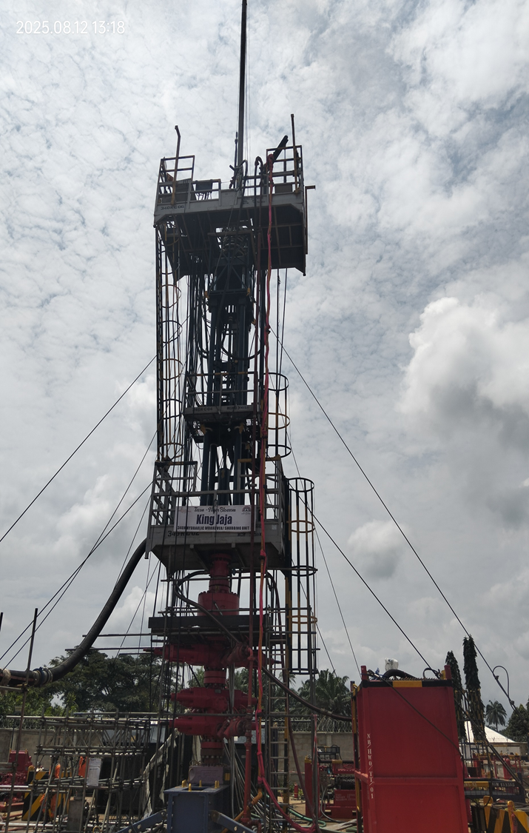
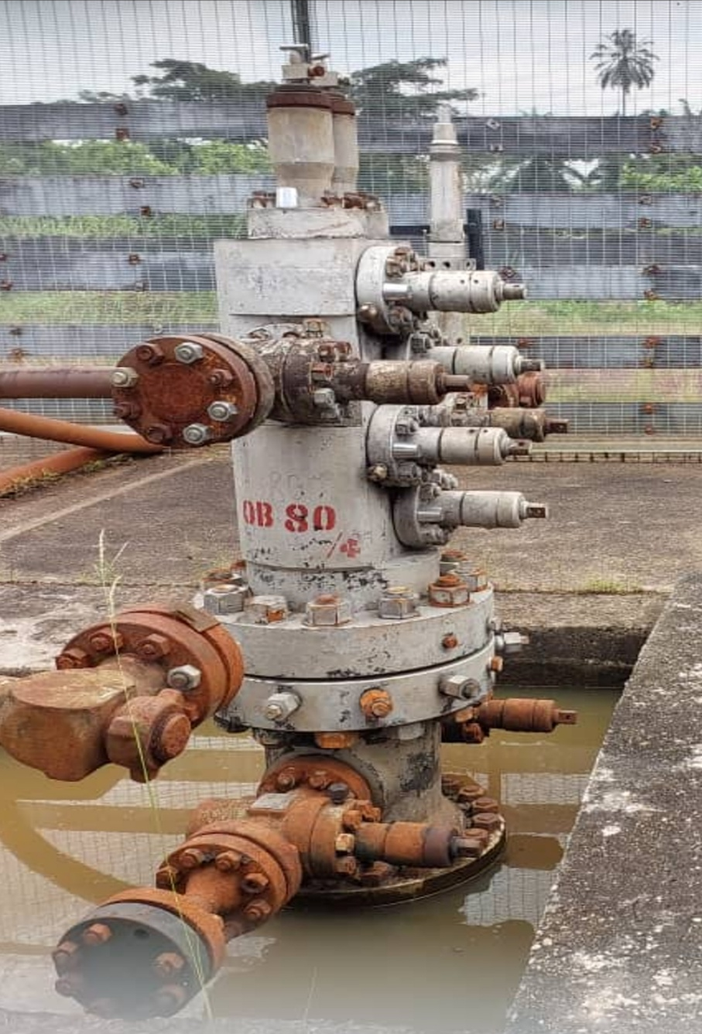
PICTURES FROM OBAGI 80 OPS

Slide 31
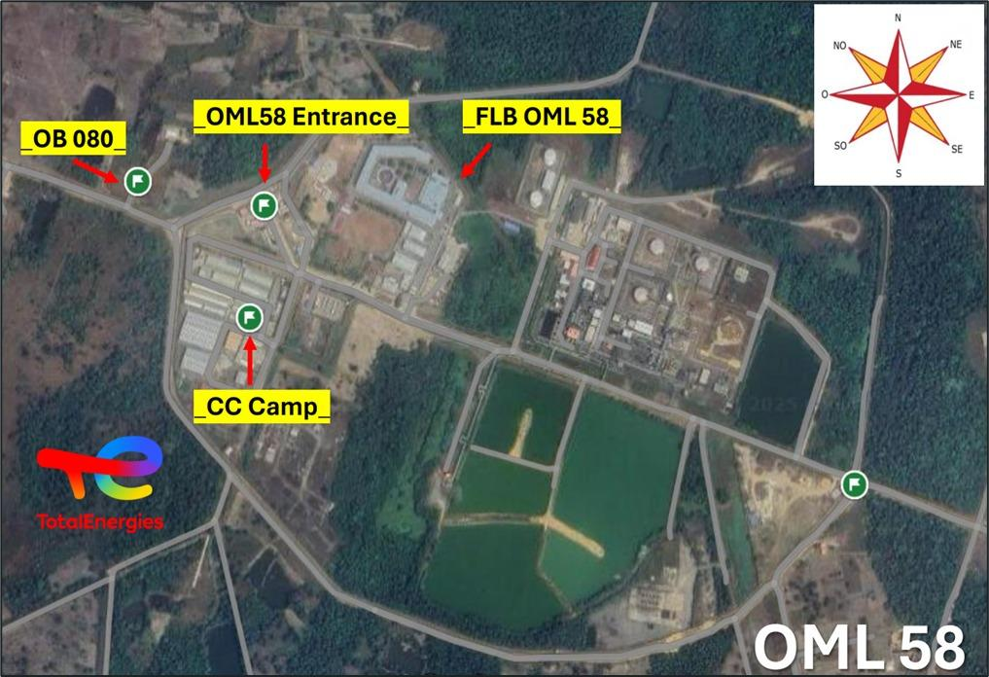
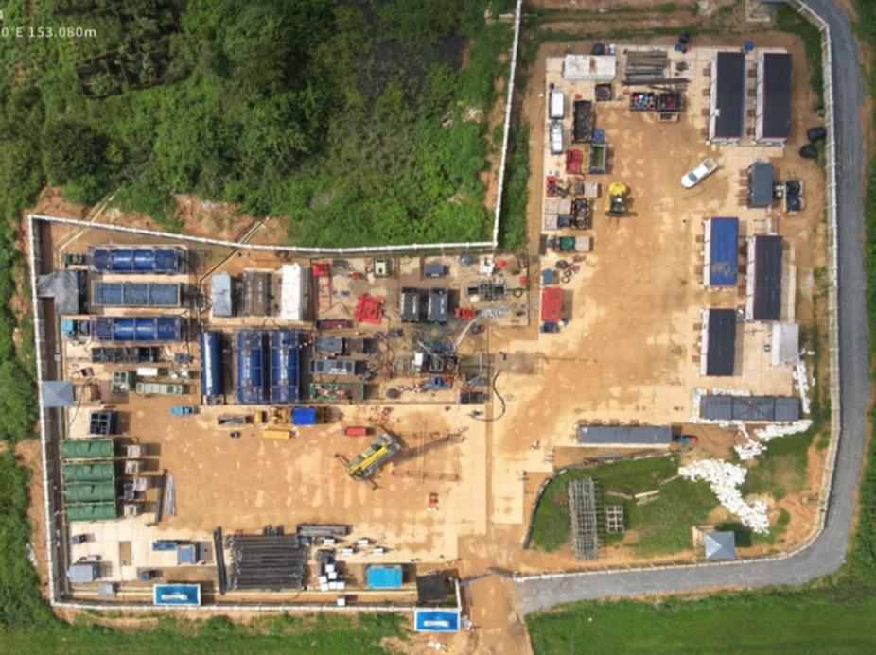
MAP OF OML58
ARIAL VIEW OF OB80 WELLPAD

Slide 32
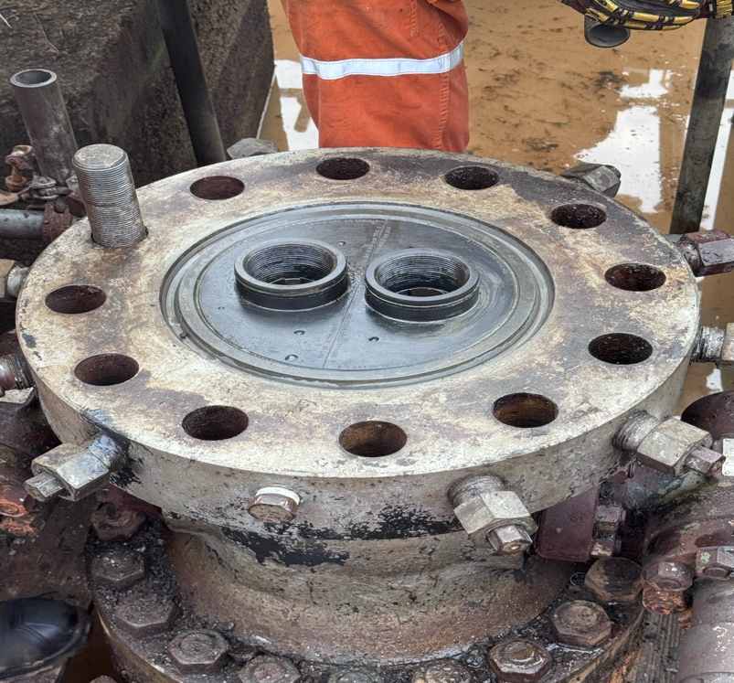
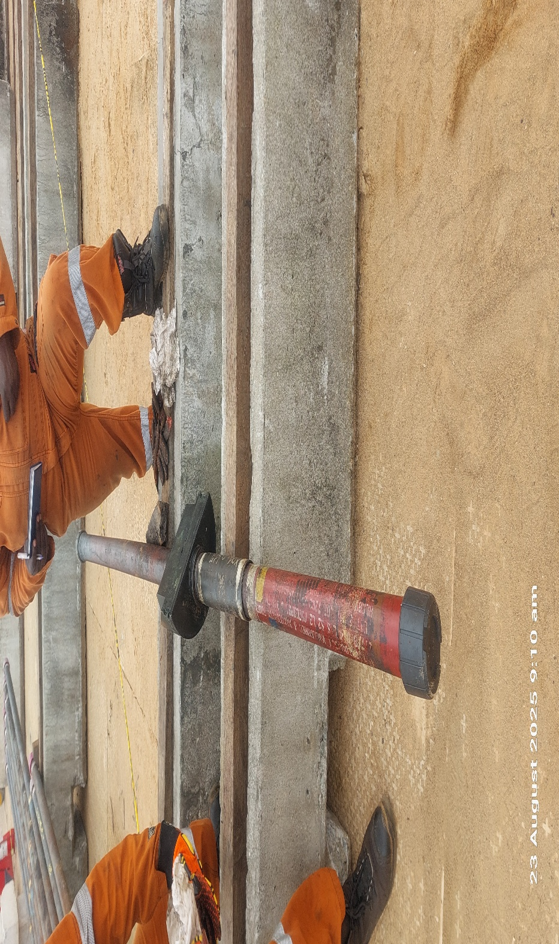
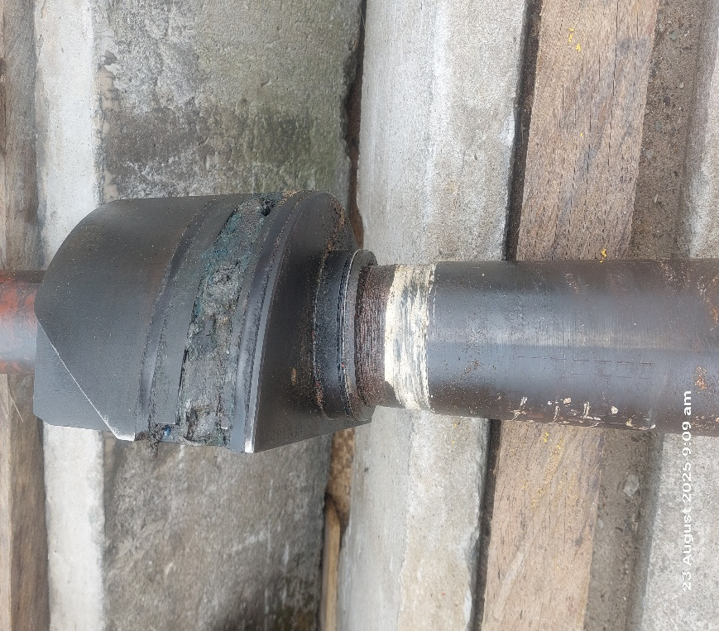
THS & TBG HANGER OF OB WELL 80

Slide 33
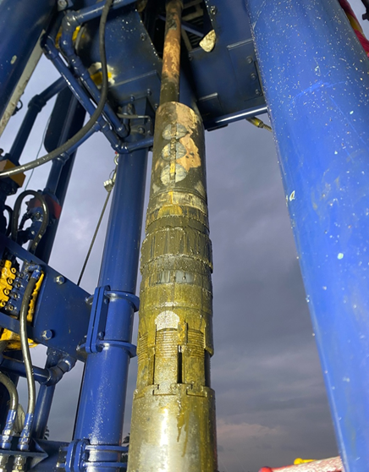
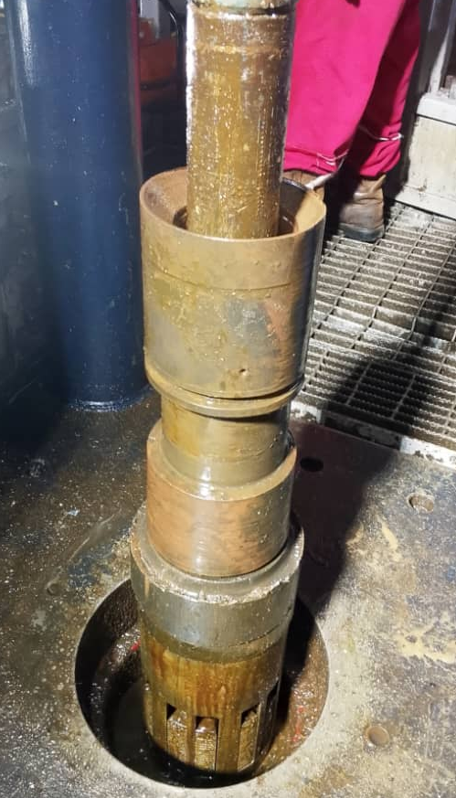
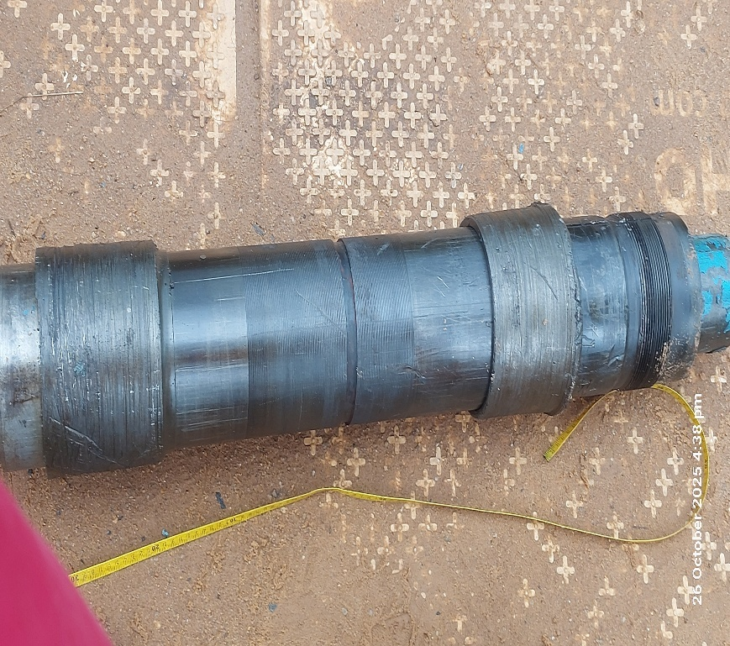
RETRIEVED PACKERS FROM OB WELL 80
BAKER MODEL D PACKER (UPPER)
A5 PACKER
SC1 PACKER

Slide 34
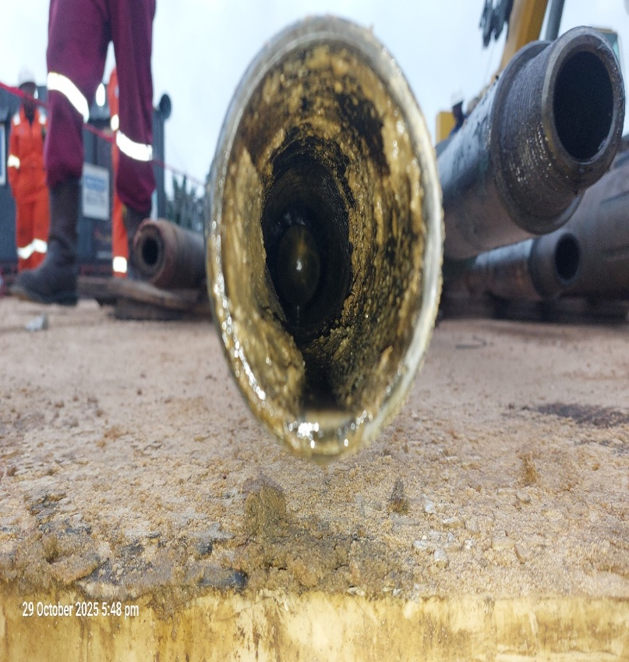
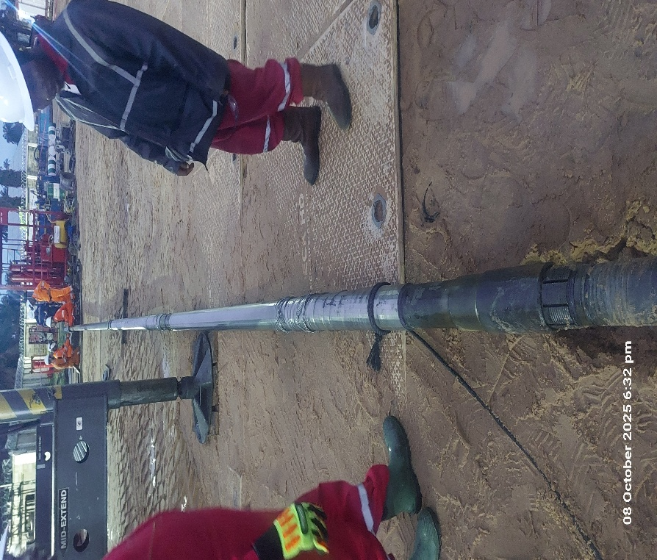
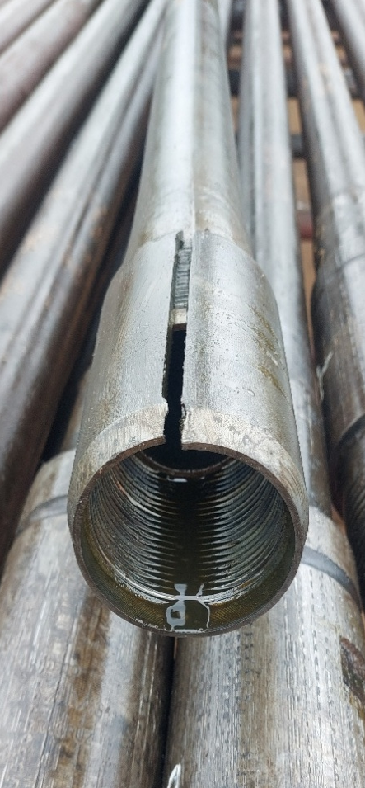
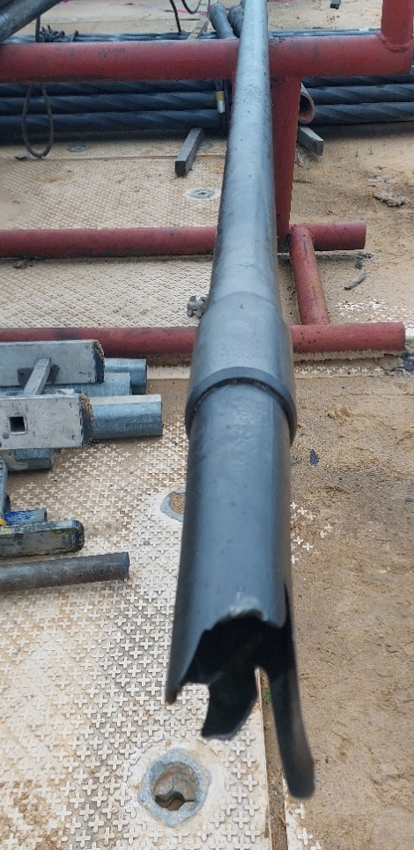
SAND SCREEN
PARTED OLD L/S TBG FISHED OUT
TBG PLUG IN FISHED OLD L/S

Slide 35
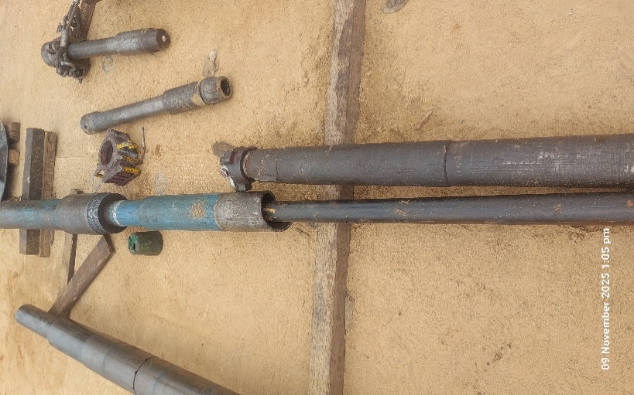
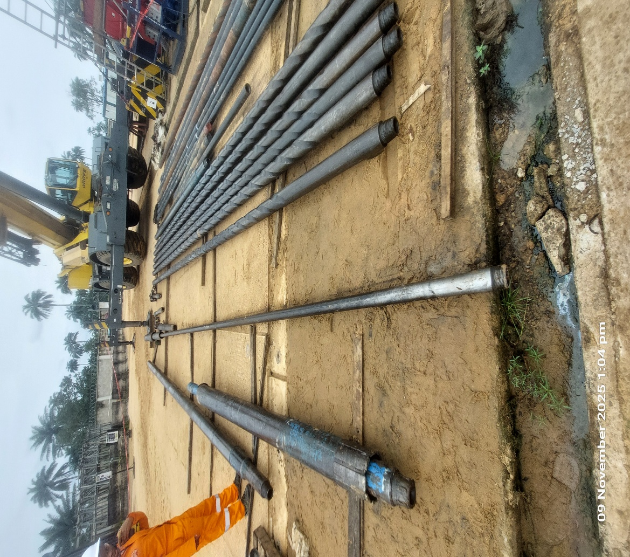
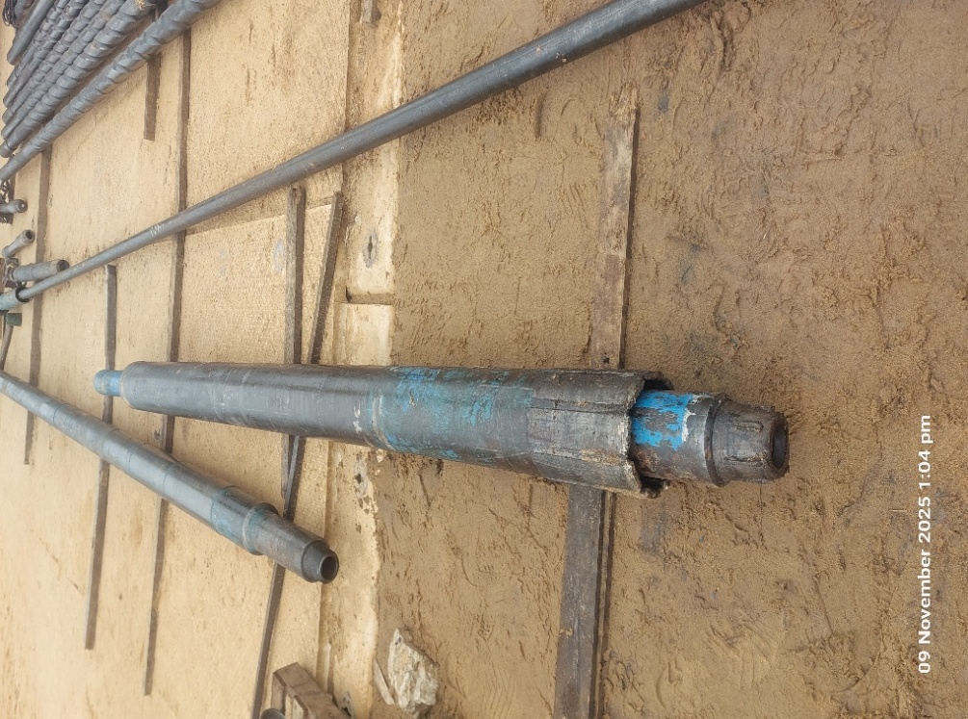
FISHED BLAST JOINT
FISHED LIH WASHOVER SHOE

Slide 36
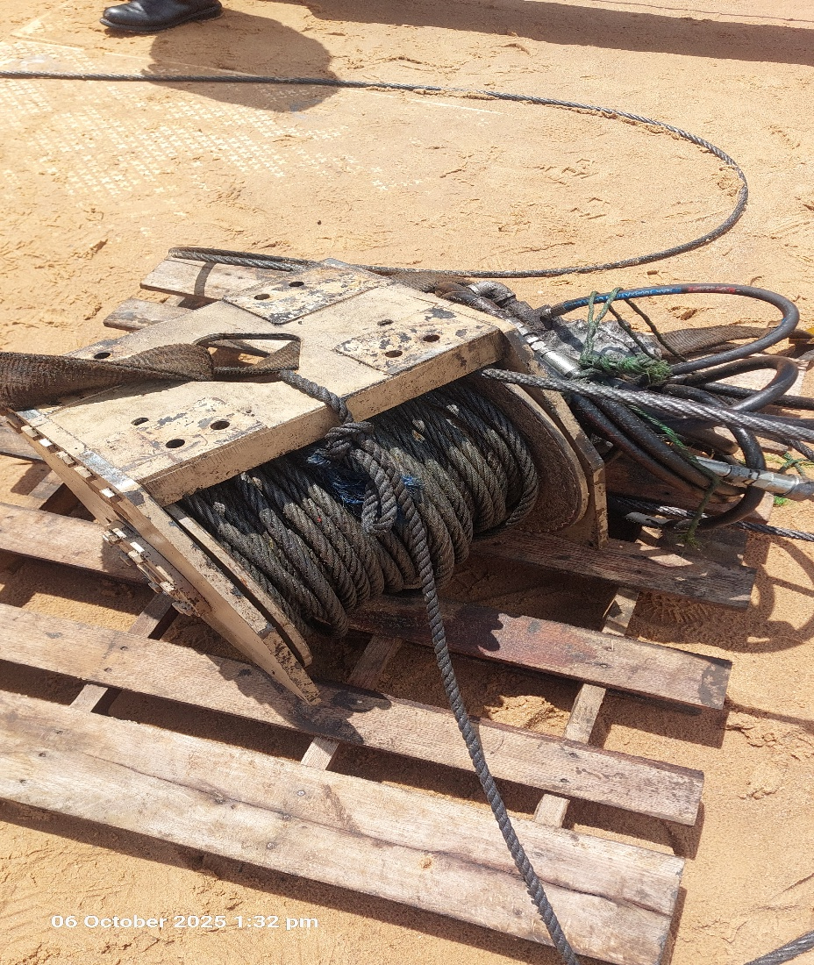
DAMAGED MAIN WINCH DRUM FROM THE GIN POLE

Slide 37
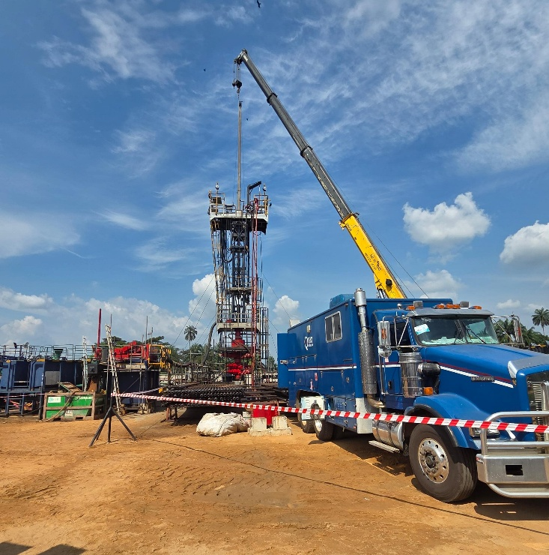
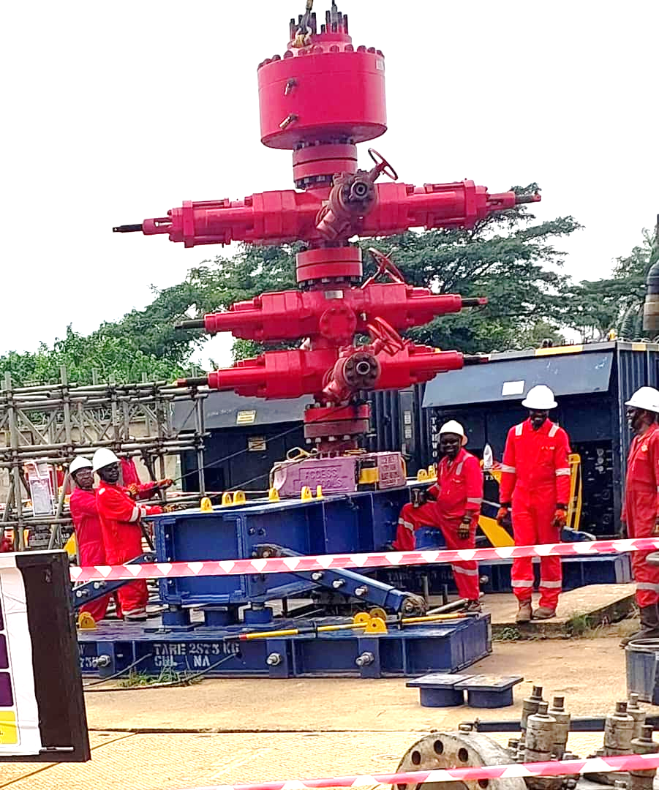
SLICKLINE OPS ON HWU
LID & BOP R/U ON WELL HEAD

Slide 38
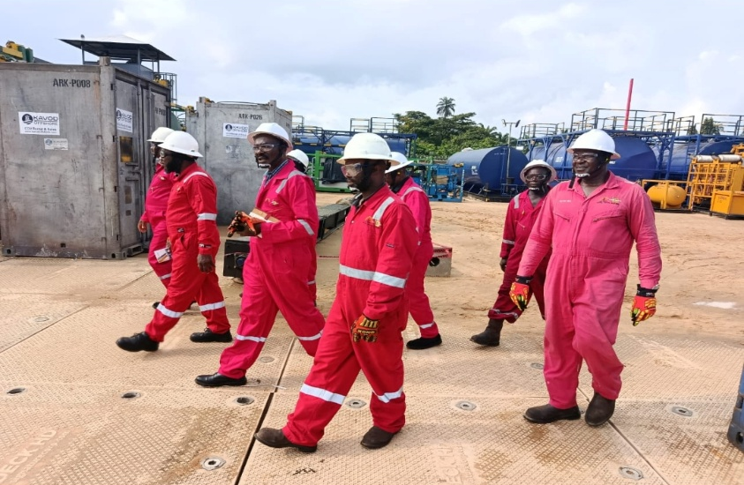
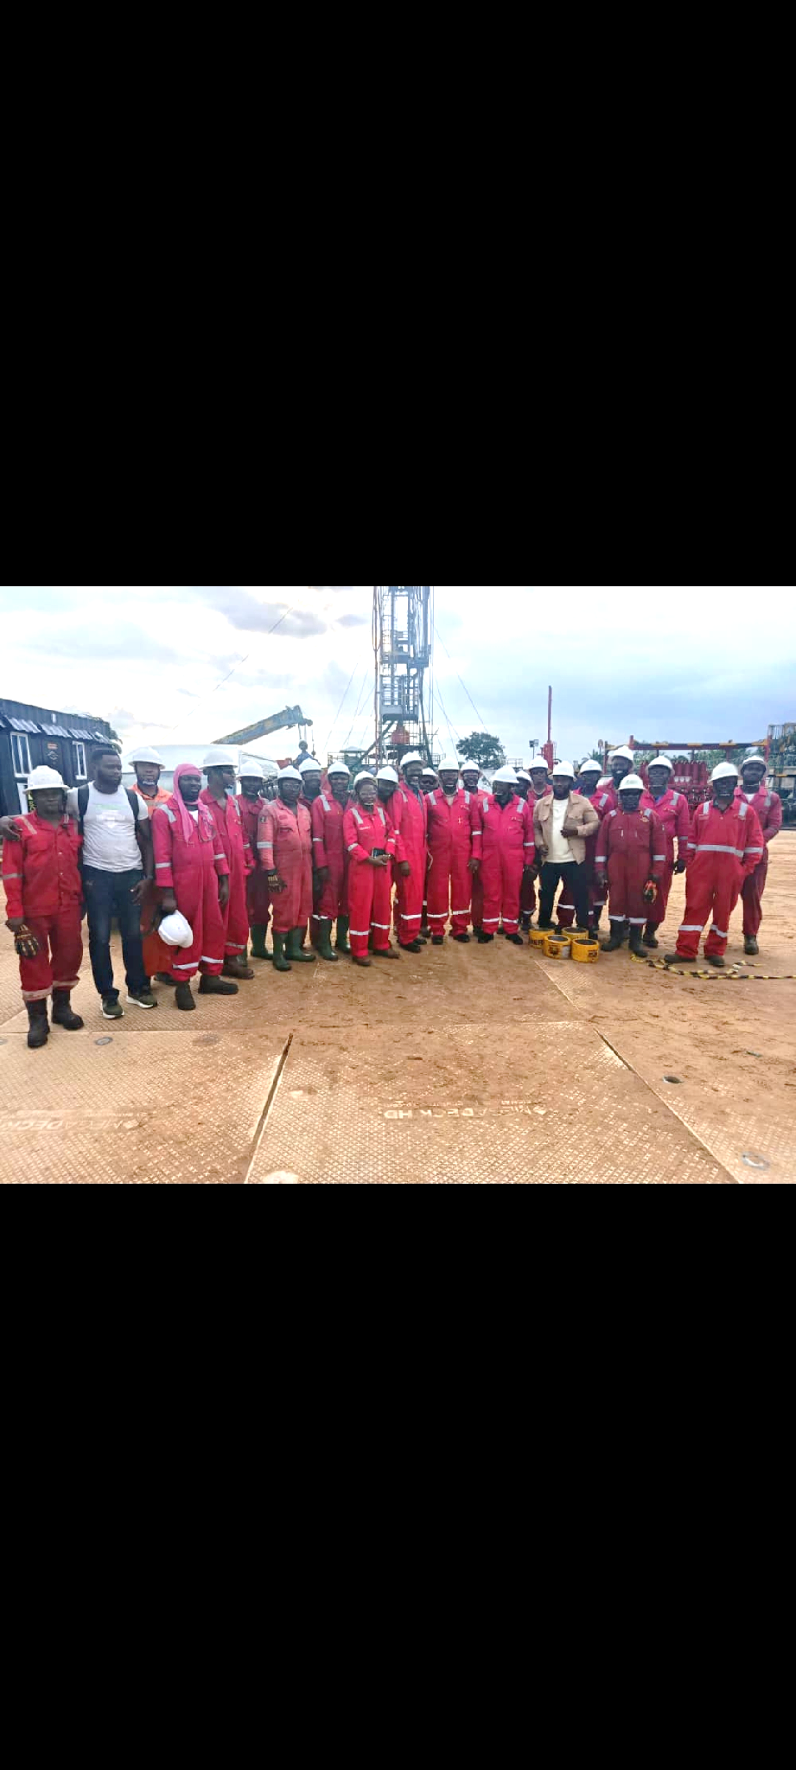
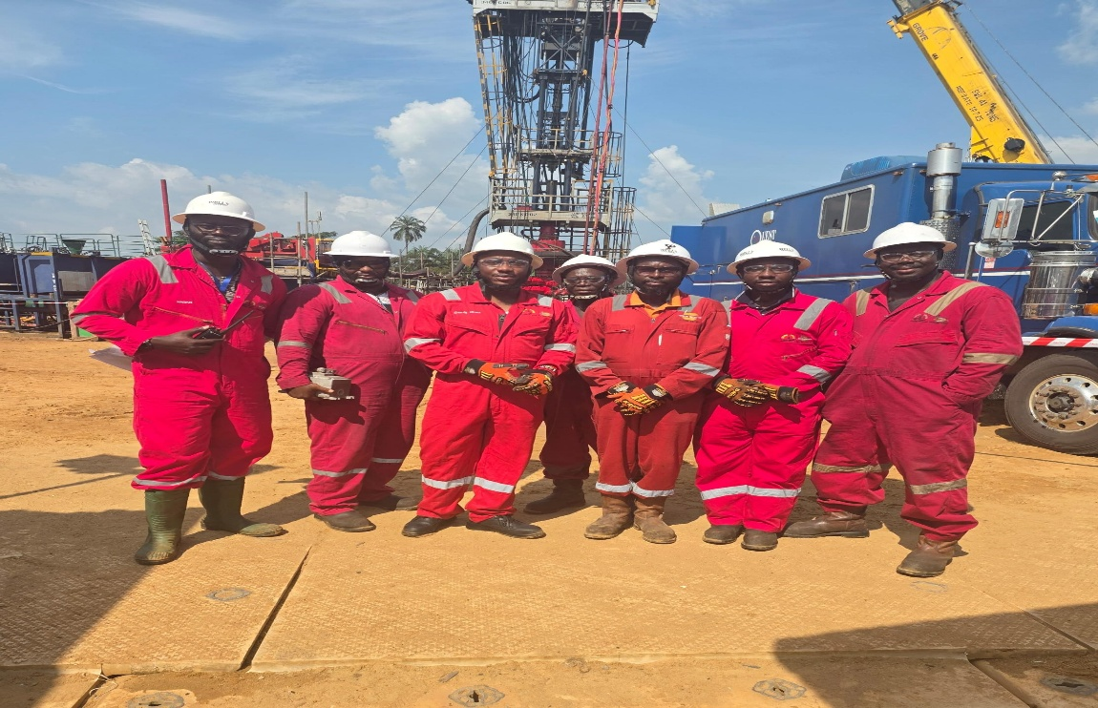
MANAGEMENT FIELD VISIT TO OBAGI 80

Slide 39

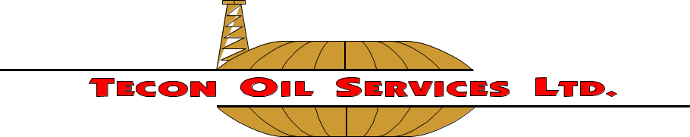
THANK YOU

