Slide 1
2025 HSE PERFORMANCE REVIEW
Venue:
Frequency: Annually (in addition to AARs)
Date: 26-03-2026
Time: -8:00 a.m.
Chairman:

Slide 2
INTRODUCTION
This review evaluates SWDA Group’s HSE performance in 2025 against established objectives, legal requirements, and industry best practices. It provides management with a basis for assessing the effectiveness of implemented HSE programs and supports continual improvement.
The review also ensures that health and safety risks are adequately controlled, identifies performance gaps, promotes compliance with regulatory and contractual obligations, and reinforces a strong safety culture across the organization.
Note: AAR’s were held during the year.
Notes:
‹#›

Slide 3
HSE Focus Area | HSE Objectives to be fulfilled | Target/ KPI
Leading, Organising and Participating in HSE Programs | -Execute planned management site visit (MSV) - Conduct planned internal and external audits. - Follow up and close-out of all MSV actions. -Conduct management tour (MT) at base -Recognition of Staff for compliance | -75% participation of managers in planned MSV. - at least 4 MSV & 6 audits. - >75% closure of gaps. -at least 3 (75%) management tour -4 award presentation
Active involvement in HSE meetings. | -Attend planned SWDA General HSE Meeting and other relevant meetings. - Facilitate HSE Presentations. | -85 % attendance -8 HSE Presentations.
Performance Monitoring | - Execute monthly monitoring of HSE Key Performance Indicators. -Review Contractors Performance. -Planned internal and External Audits -Execute Management Field inspections and Management tours | -100% contractors review. -85% Internal & External Audits.
Health/ Wellness performance | -Create awareness on prevalent health risks. | - 7 health presentations (85%)

Slide 4
HSE Focus Area | HSE Objectives to be fulfilled | Target/ KPI
Workforce Medical Fitness. | -Annual medical screening for all staff. -Provision of HMO services to every staff. | 100 % FTW compliance
Incident reporting and investigation | -Issue Award for near miss reporting. -LFI Sharing | -2 LFI Presentations.
Hazard control | -Conduct risk assessment and update risk register -Carry out HSE controls tour -Execute UA/UC reporting -Execute Near miss reporting -Execute HSE Induction for all new employee, clients and visitors -Implement Annual HSE Training Plan | -1 Risk Assessment review. -1 STOP Awareness Session -700 STOP Cards (Base) -100 STOP Cards daily (Field) 10 Incident report form 100% Induction -17 HSE Courses
Emergency Response Preparedness | -Conduct Emergency Drill -Ensure ER resources are available and certified. -Ensure action items are closed. | - 7 ER Drills - 80% closure of open items
HSE Rules | -Staff re-orientation of the new 9 lifesaving rules. | -1 Awareness Session. - 4 TBTs
Community Relation | -Foster cordial relationship with community | -at least 1meeting
Carbon Emissions | -Calculate SWDA’s carbon footprint -Carry out awareness sessions | - 1 awareness session

Slide 5
TABLE 1a: 2025 HSE KEY PERFORMANCE INDICATORS / 2025 KPI TARGET
S/N |  | LEADING INDICATORS | Target Value (%) |  | 2025 Performance | Total planned Value (NO.) | Base Plan | Field Plan | Remark
1 |  | No of UA/UC/SP reports | 100 |  | 381 | N/A | 700 | 100 daily | 57% increase from 2024 at the base
2 |  | Near miss Reporting | 85 |  | 0 | 10 | 4 | 6 | 100 % decrease from previous year
3 |  | Management HSE Presentation | 100 |  | 15 | 8 | 8 | N/A | 66 % increase from 2024
4 |  | Emergency Drill Exercise | 100 |  | 4 | 7 | 7 | 1 weekly | below target
5 |  | Management Site Visit | 75 |  | 2 | 4 | N/A | 4 | Undocumented reports
6 |  | Management Tour | 75 |  | 1 | N/A | 4 | N/A

Slide 6
S/N |  | LEADING INDICATORS | Target Value (%) |  | 2025 Performance | Total planned Value (NO.) | Base Plan | Field Plan | Remark
7 |  | Internal Audit | 66 |  | 2 | 3 | 3 | 3 | Nil done in the previous year
8 |  | External Audit | 75 |  | 1 | 4 | N/A | N/A | 25% Implementation
9 |  | New Employee/ IT /Client Induction | 100 |  | 168 | N/A | 100 % | 100 %
10 |  | Trainings | 88 |  | 15 | 18 | N/A | N/A
11 |  | Medical Fitness Certification | 100 |  | 255 | 368 | N/A | N/A | 69% FTW
13 |  | Health lectures/Presentations | 85 |  | 6 | 7 | 7 | 1 weekly
14 |  | Carbon Emission Awareness Presentation | 100 |  | 0 | 1 | 1 | 1
15 |  | HSE Awards | 100 |  | 7 | 4 | 4 | 1 weekly

Slide 7
NO |  | LAGGING INDICATORS | 2025 Target |  | 2025 Performance | 2026 Target | Base Target | Field Target | Remark
1 |  | Fatality | 0 |  | 0 | 0 | 0 | 0
2 |  | Lost Time Injury (LTI) | 0 |  | 0 | 0 | 0 | 0
3 |  | Occupational Illnesses | 0 |  | 0 | 0 | 0 | 0
4 |  | Medical Treatment Cases | 0 |  | 0 | 0 | 0 | 0
5 |  | Restricted Work Cases | 0 |  | 0 | 0 | 0 | 0
6 |  | Lost Work Day Case (LWDC) | 0 |  | 0 | 0 | 0 | 0
7 |  | Loss Time Injury Frequency (LTIF) | 0 |  | 0 | 0 | 0 | 0

Slide 8
 | NO LAGGING INDICATORS | 2025 Target |  | 2025 Performance | 2026 Target | Base Target | Field Target | Remark
8 |  | Total Recordable Cases (TRC) | 0 |  | 3 | 0 | 0 | 0
9 |  | Road Traffic Accident (RTA) | 0 |  | 0 | 0 | 0 | 0
10 |  | Community Incidents | 0 |  | 1 | 0 | 0 | 0
11 |  | Security Incidents | 0 |  | 0 | 0 | 0 | 0
12 |  | Property Damage | 0 |  | 0 | 0 | 0 | 0

Slide 9
2025 PLANNED VS ACTUAL HSE TARGETS
DESCRIPTION | PLAN (% / No.) | ACTUAL (% / No.)
Zero Loss Time Injury (LTI) in all operations | 0 | 3
Medical Screening | 100 % | 69%
Health Presentations | 86% | 100%
UA/UC Reporting | 100 % | 54%
Near Miss reporting | 100 % | 0%
Implementation of 2025 Training Plan | 100 % | 98%
Execution of Quarterly HSE Award Scheme | 100 % | 100%
HSE meetings | 100 % | 80%
Emergency Drill | 100% | 80%
New Employee / IT Induction | 100% | 100 %
Road Traffic Accident | 0 | 2
HSE Internal & External Audit | 100 % | 57%
Trainings | 100 % | 83%
Compliance to health and environment regulations | 100 % | 100 %

Slide 10
2025 Targets Analysis
Annual Medical Certification: - 255 out of 368 personnel were certified, priority was given to field staff.
15 Out 18 Trainings were conducted.
Safety Intervention Program: - 381 STOP cards out of the target of 700 were raised at the base.
Near miss reporting remains an area of concern.
HSE Award Scheme – Introduction of HSE Champions Recognition initiated and financed by a management staff.
HSE Meetings-14 out of 17 HSE Meetings conducted.
HSE Audits- 2 out of 3 internal audits planned were executed and 2 out of 4 external audits scheduled were conducted (Energy Ray, Field Test including Ravens Event and Crownhawk Express.
Compliance: 0 Citations /NON.

Slide 11
MANAGERS COMMITMENT TO HSE MEETINGS
GREEN (≥ 70% Attendance
AMBER (50% - 69% Attendance)

Slide 12
Corrective ACTIONS

Slide 13
2025 TARGET OVERVIEW

Slide 14
2025 QHSE TRAINING
S/N | COURSE TITLE
1 | Mobile Crane Operator
2 | Forklift Operator
3 | Banksman/Slinger
4 | Accredited Gas Testing & Monitoring Training
5 | Advanced Fire Fighting Course
6 | Designated First AidCourse
7 | Confined Space Training
8 | Permit To Work, JHA & HAC
9 | T-FOET (DPR)
10 | T-BOSIET
11 | Drilling well control programme (IWCF)
12 | Personnel in Charge of Lifting Course (PIC)
13 | Hazard Analysis and Critical Control Point (Food Safety) Course
14 | Non-Conformance Reporting – 5 Y Root Cause Analyses

Slide 15
QHSE AWARENESS SESSIONS
STOP AWARENESS TRAINNG | JUDITH ABEZE
CONTRIBUTORY PENSION SCHEME & RETIREMENT PLAN | MR. CHIKA IBEABUCHI
DROPS AND WORK AT HEIGHT CAMPAIGN | ENGR. OLUGBENGA BAMIDURO
ALICO INSURANCE | MRS IJEOMA ONYEWUCHI
HSE OBJECTIVES,TARGETS FOR 2025 | MR. HENRY AYANRUOH
AWARENESS ON HIV/AIDS | WINIFRED OFOMA
CAPITAL CITY DEVELOPMENT LTD | MR. JEREMIAH ONYEBOLISE
CAMPAIGN ON HANDS AND FINGER SAFETY | ENGR. CHIJIOKE UCHENDU
MANUAL HANDLING AND MUSCULOSKELETAL DISORDER | MRS TONA KADIRI
EYE CARE ( PRISTINE EYE CARE) | DR. AWULI
ALCOHOL AND DRUGS POLICY | MR. CHIKA IBEABUCHI
OVERVIEW OF HYPERTENSION | LOVETH OSISIOGU
WORK ETHICS | MRS NKOLI OKEKE
EDUCATION RETIREMENT PLAN ( STANBIC IBTC) | ESSIEN OGHENE
SAFE MECHANICAL LIFTING | ENGR. EMMANUEL OBIDIOZOR
LEARNING FROM INCIDENT | ENGR. CHIJIOKE UCHENDU
CONTRACTOR MANAGEMENT | ENGR JUDE UDEBHULU
SECURITY TIPS | MR AUSTIN USIFO
LFI PREVALENT DISEASES AND PREVENTION | ENGR AKPOS ITSEKOR
QUALITY MANAGEMENT SYSTEM | MR. MICHAEL IHUOMA
LFI FROM THE INCIDENT INVOLVING THE GROVE CRANE | MR. MICHAEL EKWO
ADVOCACY FOR FRUIT CONSUMPTION | MRS. LILIAN
TEMPORARY PIPE WORK AND PTW | ENGR. CHIJIOKE UCHENDU
LEADWAY ASSURANCE | AMARIS KALU AND AMAKA NOBLE
LONE WORKING AWARENESS | MR. MICHAEL EKWO
LIFE SAVING RULES | MR. CHINEDU OGUEJIOFOR

Slide 16
SWDA GROUP HSE PLAN FOR THE YEAR 2025
YEAR | JAN | FEB | MAR | APR | MAY | JUNE | JULY | AUG | SEPT | OCT | NOV | DEC
2024 | BASIC FIRST AID, FIRE FIGHTING, FOOD SAFETY | WAH AWARENESS | DRILLING WELL CONTROL PROG. (IWCF) | ISO 450001 | BEHAVIOURAL SAFETY & STOP REPORTING, | DDC, AGTM, DES. FIRT AID, ADV. FIRE FIGHTING, PTW-JHA-HAC, CSER | IWCF | DESIGNATED FIRST AID. |  | IADC F0RKLIFT/ CRANE OPT/ BANKSM AN/SLING ER | PPE USAGE & MAINTENANCE
 |  |  |  | T-BOSIET
2025 | IADC F0RKLIFT/ CRANE OPT/ BANKSM AN/SLINGER & PIC. FOOD SAFETY & HYGIENE, | STOP AWARENESS | IWCF |  | DEFENSIVE DRIVING COURSE (DDC) Journey Mnagaers Course | FIRST AID, FIRE FIGHTING, T- BOSIET, PTW | MANUAL LIFTING, IWCF, MAN-RIDING | IWCF, BASIC OFFSHORE SAFETY IND.& EMER. TRAINING, DDC, ADV.FIRE FIGHTING | IWCF | ISO 45001 | . AGTM, CSER, IWCF, ADV. FIRE FIGHTN
2026 | PTW-STOP | AGTM, CSE | MGT OF RIGGING &LIFTING | MOC | HUET, ADV. FIRE FIGHTING | IADC BKSMAN, CRANE, FLIFT, AGTM, CSER | IWCF, JOURNEY MGT | BASIC FIRST AID, DDC, PTW | DROPS, LINE OF FIRE, PIC, IWCF | BASIC FIRST AID | JOURNEY MGT. PTW-HAC-JHA
2027 | DES. FIRST AID. | STOP REPORTING AND BEHAVIOURAL SAFETY |  | T-BOSIET |  | DES. FIRST AID PTW | T-BOSIET |  | T-BOSIET
NOTE: Additional trainings may be conducted on clients’ request, needs analysis, employment basis, or other specific requirements.
Legend: Green=Completed Peach= Prospective Red=Missed

Slide 17
APPENDIX 6b: HSE INTERNAL AUDIT PROGRAM FOR THE YEAR 2025
Four- Monthly | Month/Year | Auditee (Department/Rig) | Audit Type | Team Leader | Audit Team
1st 16 weeks | April, 2025 |  | HSEMS (Contractor & Supplier Management, Risk Management, Design & Planning)
2nd 16 weeks | July, 2025 |  | HSEMS (Implementation & Monitoring, Assessment & Continuous Improvement)
3rd 16 weeks | November, 2025 | All departments | HSEMS (Commitment & Leadership, Policies & Objectives, Organization & Resources

Slide 18
TABLE 7: 2025 EXTERNAL QHSE AUDIT PROGRAM
MONTH | CONTRACTOR | Audit Type | AUDIT TEAM
 |  |  | Team Lead | AUDIT TEAM MEMBERS
April 15, 2025 | Energy ray Integrated Services/Field Test Control Ltd. | Inspection | Irenus Emeruem | Uche Uduhiri, Chijioke Uchendu, Aladekoba Deji, Okey Egbuta, Judith Abeze, Micheal Ihuoma
June 20, 2025 | Goldworld Resources | Road Transport / Journey Management | Emmanuel Obidiozor | Manafa Stephen, Kalu Ukpai, Winifred Ofoma, Gbenga Bamiduro
August 19, 2025 | SOWSCO Nig LTD. | Inspection/Material | Ken Oga-Eluwa | Henry Ayanruoh, Dandy Ilione Uche Uduhiri, Sunny Timeh, Winifred Ofoma, Micheal Ihuoma
October 21, 2025 | Ponyx Hospital/Cova care | Medical Services | Jude Udehbhulu | Ken Oga-Eluwa, Tony Oputa, Tona Kadiri Chukwudi Udeh.

Slide 19
TABLE 8: MANAGEMENT FIELD ENGAGEMENT FOR THE YEAR 2025
 | QUARTER - 1 | QUARTER - 2 | QUARTER - 3 | QUARTER - 4
 | January - March | April - June | July - September | October - December
Management Team | Team 1 | Team 2 | Team 3 | Team 4
MANAGEMENT TOUR
Management Team | Team 1 | Team 2 | Team 3 | Team 4

Slide 20
2025 AUDIT & MFI TARGETS (period JAN-DEC) contd.
AUDITS & INSPECTIONS | PROJECTED | ACTUAL
HSE Internal audit | 3 | 2
Contractor (third party) HSE audit | 4 | 2
Management facility Engagement (MFE) | 4 | 2
Notes:
‹#›

Slide 21
2023-2025 KEY PERFORMANCE INDICATORS
2023-2025 OCCUPATIONAL HEALTH AND SAFETY KEY PERFORMANCE INDICATOR CHART

Slide 22
MONITORING ACTIVITIES
STOP Reporting
Customer review
Environment ( Vegetation, water, compliance)
Welfare
Health ( FTW)

Slide 23
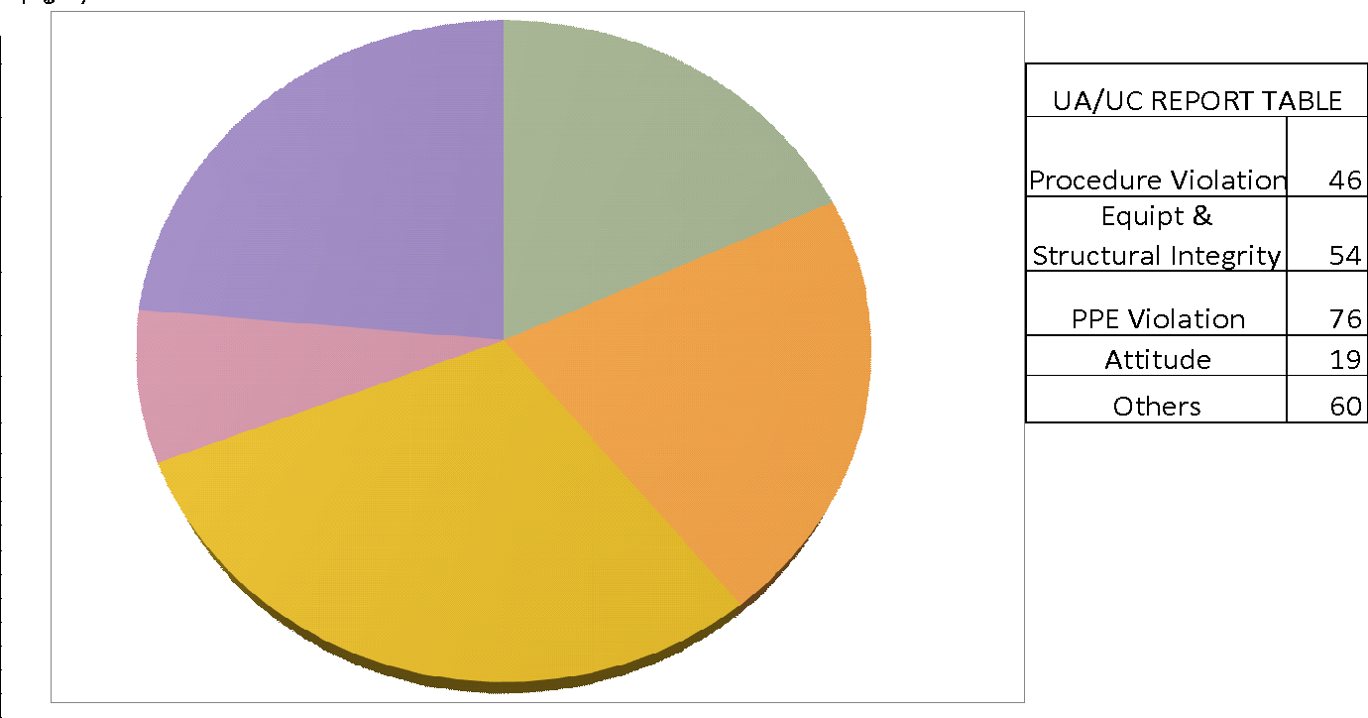
UA/UC REPORT

Slide 24
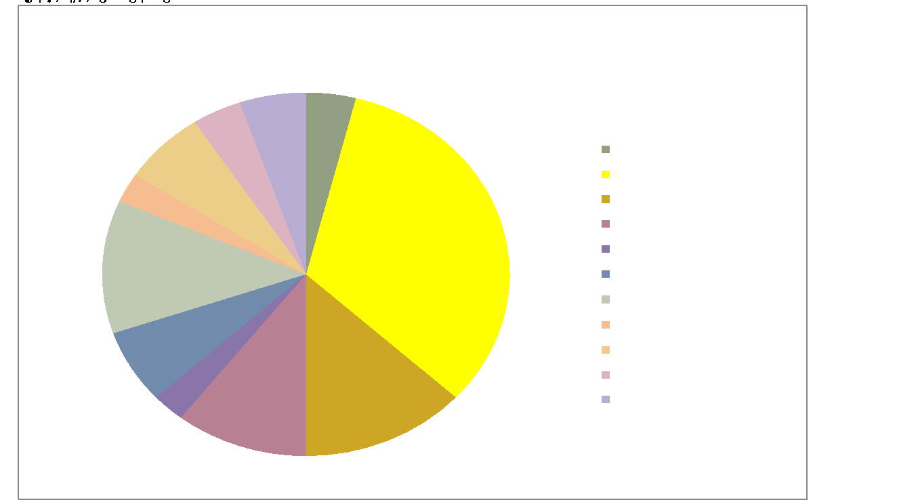

Slide 25
Environmental Threats
Vegetative state of the environment.
Undulating access road within the premises.
Noise Pollution/Spill from forklift trucks and cranes.
Littering of premises with equipment and waste.

Slide 26
Enforcement Authorities/Legal requirements
Bushy Environment, fertile grounds for reptiles and pests.
Water portability
Recertification of fire extinguishers
Drainage system- Ware house
Waste management system
Quarterly fumigation

Slide 27
Health Surveillance
FTW Review (Hypertension, Diabetes, Audiometry)
Non compliance of FTW for base workers

Slide 28
Workers Perception/Complaints
Personal Protective Equipment/Clothing.
Health Management Scheme
Remuneration
Leaky roof at MFS Warehouse
Presence of Biological hazard: Cow
Canteen

Slide 29
QA/QC Review
Management of lifting equipment and lifting accessories
Preservation of WS/DS
Calibration
Customer Satisfaction review / complaints form not in use.
Equipment Maintenance/Failures.
Effective NCR Management in Total Operations regarding internal cutter failure during function testing.
Gaps in pressure control equipment familiarization

Slide 30
Effectiveness from previous reviews
Improvement in implementation of Audits, inspections, meetings and management presentations.
Base-Field dichotomy still present in risk management.
STOP reporting has improved by a small margin though near misses remains unreported.
Internal sub-contractors included in HSE audit.

Slide 31
2025 HSE PERFORMANCE OVERVIEW
HSE Highlights
Successfully completed rig mobilization to all client wells on schedule and without any RTA
Secured and executed contracts in Fishing, Casing Jack operations, Work Strings, Drill String Tool Rentals, and Casing operations. Major clients included Chevron,, Total Energy, Aradel, Seplat, Nuway Oaklane, Scopio Drilling.
Achieved well objectives ahead of schedule at Kolo Creek 23, Opukusi, Elepa (), Aradel Holdings (Olo well2 & 9 Elele) and Chevron Wells - Gbokoda 1 and 2, Dibi, Abiteye, Opukeba.
Conducted planned trainings such as First Aid, Firefighting, 5Y NCR Course, PIC, Confined Space, Gas Testing, Defensive Driving Course (DDC), Permit to Work, IWCF, Food Safety, DFA, IADC, and Permit To Work (PTW).
Maintained efficient material response times from the base to operational sites.
Notes:
‹#›

Slide 32
Successfully executed the Annual Condition Survey (ACS) for Rig 101 and HWO units, securing valid ACS reports for 2026/2027 from DPR and consultants at SWDA Energy Park..
Excellent Performance in Chevron Contractor Assessment.
Successfully CompleteD, Ogbele well9 (Aradel holding), OML58 well80 (Total Energy) and Omofejo well3 &2 (Nuway Oaklan
Conducted management field engagement as well as HSE Audit to OML58 (Total Energy, (Rig 101), Ogbele Wells 4, 9 and 6, Kolo Creek Well 23 and Ahia well 9.
SWDA personnel received multiple Behavioural-Based Safety Awards from clients at various rigs.
Performed Fitness for Duty (FFD) checks for all field staff.
API Spec Q2 and ISO 9001 – 2015 Surveillance Audit Completed.
Successfully reviewed SWDA Energy Park Risk Assessment.
Updated and validated all QHSE documentation to clients to meet clients tendering and bidding processes as well as internal HSE requirements.
Development of HSE Repository

Slide 33
Over 90% of SWDA staff had access to healthcare services through Mbando & Baston HMO.
Maintained medical retainership and annual certifications for staff with Ponyx Hospital, Westend Hospital, First Rivers, CIMS Hospital, Cova Care and other facilities near operational locations.
Organized health presentations and lectures for staff and contractors to promote wellness.
Conducted MEDEVAC drills at client rig sites and SWDA vase to ensure readiness for medical emergencies.
Conducted risk assessments and prepared plans before rig mobilization to ensure operational safety.
Reviewed safety-critical documents (e.g., HSE Case, Risk Management Procedure, and HSE Plan) with clients and HSE-critical staff.
Conducted inductions all through the year for field personnel, contractors, community workforce, and visitors at rig sites and base offices.
Provided training and certificate revalidation for key personnel in courses such as IWCF, Dedicated First Aiders, Firefighting, Defensive Driving Course (DDC), Gas Testing, and Permit to Work (PTW), enhancing staff and contractor competence.
Fostered excellent interpersonal relationships with host communities at all fields and locations.
Received no environmental or health non-conformance notices from government regulatory agencies during their inspections throughout the year.

Slide 34
SWDA Group 2025 HSE LOWLIGHTS
Inability to enrol all personnel into the HMO scheme.
Poor participation of personnel in Unsafe Acts/Unsafe Conditions (UA/UC) reporting, especially at the base.
Inability of management to provide Personal Protective Equipment (PPE) to all base staff.
Lack of a designated changing room for Crown Hawk personnel.
Absence of dedicated personnel for the housekeeping of tools and materials at SWDA
Over-reliance on third-party vehicles for personnel movement, leading to high costs and potential traffic risks.
Leaky roof and cracks in the walls and POP in MFS Warehouse.
Records of theft at the base.

Slide 35
ARADEL OPERATIONS HIGHLIGHTS & LOWLIGHTS
Key Risk Mitigations
Weekly safety awards were issued to the most reported observation and most critical STOP card
Compliance to drill plan
Compliance to hotel inspection plan.
Areas for Improvement
Late departure from location and arrival at the hotel (7:50/8:00 p.m. -8:30/9:00 p.m.)
Frequent power outages negatively impacting on rest time and laundry activities.
Dilapitated medic office and crew room.
Constant vehicle break-down during the rig- site crew change.
Outstanding payment for catering & accommodation services resulting in unavailability of meals for rig crews.
Constant break-down of equipmnent such as cranes, tongs etc. resulting in downtime.
Unavailaility of stand-by vehicle in the event of an emergency.

Slide 36
NUWAY OAKLANE – OMOFEJO OPERATIONS HIGHLIGHTS & LOWLIGHTS
Key Risk Mitigations
PPE usage compliance
Work authorization LSR Compliance
Compliance with STOP reporting and follow up of all actions till closure
Consistency in execution of the weekly HSE Award plan.
Consistency in the implementation of emergency drill plan.
Areas for Improvement
Accommodation defects such as broken bath tops and others are rarely fixed.
Unavailability of a dedicated shuttle boat for the location, resulting in crew change delays and reduction in rest time.
Some barges had structural leaks resulting in water collection and retention,
Poor network connection in the accommodation area resulting in inability for family connection.
Unpotable water used for meal preparation.
HSE meetings not held in a conducive environment due to defective AC and few chairs.

Slide 37
TotalEnergies –OBAGI 80 OPERATIONS HIGHLIGHTS & LOWLIGHTS
Key Risk Mitigations
Regular management safety walkthrough by TotalEnergies.
Strong visible leadership form HSE Advisor and HSE Officers.
Prompt close-out of reported hazards within 48-72 hours.
Proactive Stop Work Authority (SWA) Culture.
Risk management tools such as PTW, JRA, Lifting plans and Detective Multi-Gas monitor were employed all through the operations.
PPE Compliance.
Compliance with induction and onboarding procedure.
Regular emergency drills.
Compliance to the T-card usage.
Real tome drone surveillance.
Adherence to AMC and weekly medical screening plan.
Weekly fumigation of the well pad.

Slide 38
TotalEnergies –OBAGI 80 OPERATIONS HIGHLIGHTS & LOWLIGHTS
Areas for improvement
Poor follow-up on critical safety equipment such as fire extinguishers and gas monitors.
Delayed waste disposal at the well pad.
Limited environmental awareness training for the community workers.
Poor emergency response to the invasion of bees around the crane boom and absence of emergency contact list at the well pad.
Poor fatigue management, insufficient break time for personnel to eat and rest.
Crane not certified for man-riding /rescue at height
.

Slide 39
Aradel OLO 02- RIG 101 OPERATIONS HIGHLIGHTS & LOWLIGHTS
Key Risk Mitigation
Achieved zero environmental spill.
Achieved 100% HSE meeting.
Achieved up to 95% drill compliance.
Mobilization and rig up was successfully done.
Achieved zero road traffic accident.
There was no community disturbance throughout the operation.
Excellent team work displayed by the NBDC team and service hand.
Adequate provision of most safety materials and drugs.
Waste management compliance

Slide 40
Aradel OLO 02- RIG 101 OPERATIONS HIGHLIGHTS & LOWLIGHTS
Areas for improvement
Poor maintenance culture observed in equipment issues and accommodation.
Poor quality meals served by the catering company.
Poor general toilet at the rig site.
No internet facility for personnel.
There was no lead and chase during crew change.
Welfare Issues such as inadequate provision of operational drinking water
Poor kitchen utensils for easy preparation of meals daily.
No chairs at the gallery.
No PPE for most NBDC personnel
Impact resistance hand gloves not regularly issued to personnel

Slide 41
RECOMMENDATIONS
LEADERSHIP & COMMITMENT
All Managers at various level to show evident commitment to HSE activities such as meetings, audits, inspections, Follow-up, PPE usage and leadership by example.
Access to medical facility should be made available for all staff.
Resources for training should be provided to close gaps for the year.
Adequate attention should be given to ensure maintenance schedules for equipment and vehicles are adhered to.
Staff remuneration and welfare should be considered to boost productivity and discourage turnover.
QHSE to be involved in planning and implementation activities with contactors from inception till completion.
HSE incentives/award program to be implemented at all clients' sites.
Notes:
‹#›

Slide 42
POLICIES
Active implementation of HSE procedures
Pursue contractors' awareness of SWDA Group HSE policies.
All SWDA group staff must be medically certified to work.
HSE ORGANISATION
HSE measurable targets should be attached to staff responsibilities to encourage safety performance.
HSE committee meeting should be revived to ensure staff and management participation and communication.
TRAINING AND COMPETENCE
Departmental heads to conduct In-house HSE trainings and/or awareness courses for the department.
HSE department should carry out safety awareness sessions with the workforce.

Slide 43
RISK REDUCTION MEASURES- RECOVERY
Adequate lifting gears and storage racks to be provided to maintain slings and other accessories.
Required inspections for lifting appliances and equipment should be done including those at the base.
Life saving rules awareness to be promoted.
PPE monitoring should be enhanced.
SECURITY .
Access control at the gates to be beefed up.
HSE Department should be notified of contractor's entry into the premises.
Proper security shelter to be constructed at the entrance gate.

Slide 44
EMERGENCY RESPONSE
Ambulance required in case of spinal injury at the base.
Equipped sick bay with a nurse required at the base office.
Safe haven required at the base.
INSPECTIONS
Management tour should be conducted at the base at planned intervals
INCIDENT REPORTING , INVESTIGATION AND FOLLOW-UP
Incident reporting should be encouraged.

Slide 45
20220262026 HSE PROGRAMS.docx

Slide 46
Closing Remark

Slide 47

Notes:
‹#›

